Slide 1


Android Based Online Testing System
Harshal Dalvi (A-13)
Pranav Firake (A-16)
Aditya Gaikar (A-17)
Under the guidance of:
Mrs. Nusrat Parveen

Slide 2

Overview
Motivation
Scope
Why Android?
Problem Definition
System Study
Technologies Used
Design of System
System Flow
Later Versions
Future

Slide 3

Easy and convenient platform-
android.
Immediate result.
Reduce paper Work.
Ease of maintaining statistical data
online.
It can be used at
Educational Institutes.
Organizations conducting specific objective tests.
Placement cell for conducting aptitude tests.
Motivation

Slide 4
Scope
Student:
Create an account.
Schedule / Reschedule / Cancel Test.
Appear for test.
View Results.
Administrator:
Design a test.
Update test questions.

Slide 5
Android as a base
Increasing number of android based handheld device users.
Open source mobile OS.
Portability to PC through android simulators.
OS with better graphics user interface.
Free tool as SDK for application development.
Easy delivery of android application through Google Play Store.

Slide 6
Problem Definition
A complete online testing system:
Administrator:
-making test
-maintaining their questions and temporal parameters
-conducting test and even deleting it.
-view various types of records in system.
Student
-login and give test on android enabled device.
-choose the test to give, mode of test
Marks evaluation scheme can be maintained and followed likewise.

Slide 7

System Study
Existing Systems:
1. The manual type of examination
Time wastage.
Paper work and manual assessments
2. The desktop based online test system
Low portability.
Every time laptop will be required.
Proposed System:
Easily available system.
Quick result technique.
And many others.

Slide 8
Technologies Used
Front End:
XML for frame design
Android SDK through Eclipse IDE
Back End:
Java.
WAMP synchronisation
(Apache server, MySQL, PHP)
Database Tools:
MySQL

Slide 9



Android SDK
Eclipse IDE platform
XML

Slide 10

WAMP Server
Synchronization of
Windows
Apache
MySQL
PHP/Perl/Python)

Slide 11
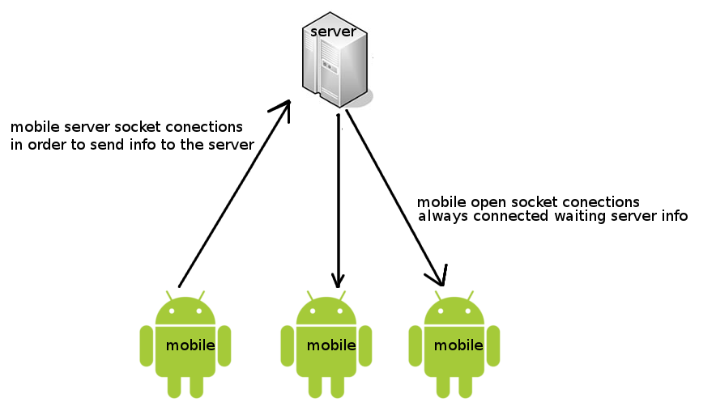
WAMP Server Usage

Slide 12
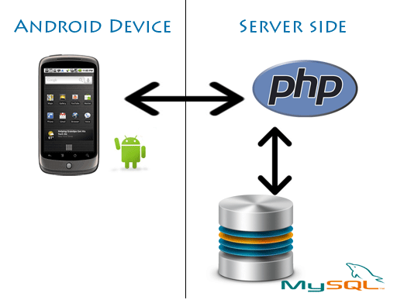
WAMP Server Usage

Slide 13
Implementation
CLIENT
(User android enabled smartphone or tablet)
LOCAL NETWORK
DB SERVER
(For MySQL)
LOCAL SERVER
DB SERVER
(for MySQL)

Slide 14
Modules of Online Exam Software:
(1) Verifier:
Authentication of users/examinees
System acts as verifier
(2) Conductor:
Admin acts as test conductor
1. Setting a test
2. Setting marks evaluation policy
3. Setting questions
Design of the System
(3) Test Giver:
Students are the actual test
givers
1. Authentication
2. Selecting the test
3. Selecting the mode
4. Giving test
(4) Result maker:
takes care of marks calculation scheme

Slide 15
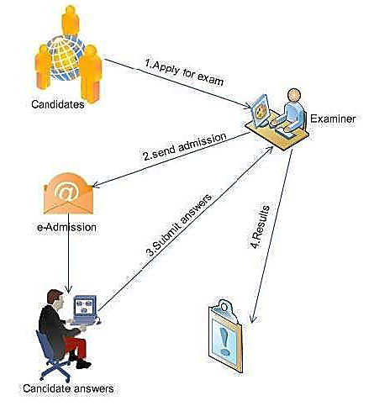
System Flow
Admin Login
Set Test Activity
Set test name/ID
Set number of
questions
Store correct answers
record
Add the questions
Set mode of test (practice/timed)
Set time for answering
Set marks evaluation scheme

Slide 16
System Flow
Student Login
Answer Test Activity
Select test name/ID
Select mode of the test
Answer the questions
Exit the test
Generate Result Activity
Compare correct answers data with answers marked by students
Follow marks evaluation policy
Calculate marks and percentile
Display Result

Slide 17
Later Versions
Graphical questions and answers
Adaptive tests based on many-choice questions
Complex authentication techniques like face recognition, fingerprint scanning, verbal passwords

Slide 18
Future
Make available on all platforms
Larger scale tests
Ability to conduct competitive examinations on a national scale

Slide 19

THANK YOU

